Slide 1
Sprint #2 Presentation: Hangout
Brandon | Dean | Eric | Ashley | Antonio

Slide 2

Prototyped Logo

Slide 3
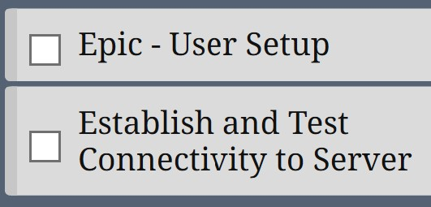
Document Updates
No major update to the Business Requirements Document.
Management Plan: Gantt Chart - specifying tasks.
When the Gantt was first created, it was filled with general goals. As time goes on, the team is able to better document the timeline of certain tasks.

Slide 4

Recap: Product Requirements Document I
Goals
Purpose: Our product aims to make meeting new people and finding new hobbies easier using available technology.
Personas
Michael Smith, the volleyball player with a busy schedule.
Notes:
Some large points in our PRD...

Slide 5
Product Requirements Document II
User Stories and Wireframes
Discussed in the demonstration.
Machine Learning
Meant to provide a competitive edge.
It’s purpose is to benefit users with an improved feed catered to their interests.
Notes:
Machine learning is discussed...

Slide 6
Architecture Design Document Updates
User Stories
No major changes to our User Stories
Component Level Diagram
A change from attempting to implement a MVC pattern has been included. (Front-End)
Necessary to implement early in development rather than later, but it did cause a delay in the creation of the UI.

Slide 7
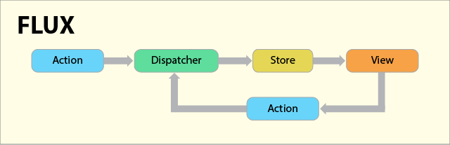
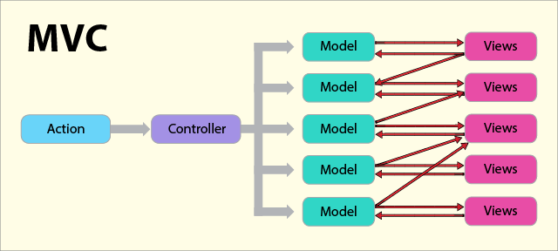
Architecture Alternative: Flux
Design Pattern used by Facebook when working with React
Manages how data flows through a React application
Data flows in one direction and kept entirely in stores
4 Main Components
Dispatcher, Stores, Views, Action

Slide 8
MVC vs Flux (Trade-off Analysis)
MVC Advantages:
High Cohesion
Loose Coupling
MVC Disadvantages
Not scalable
Multiple - Product Consistency
Flux Advantages:
Scalable
Unidirectional Data Flow
Flux Disadvantages:
Complex

Slide 9
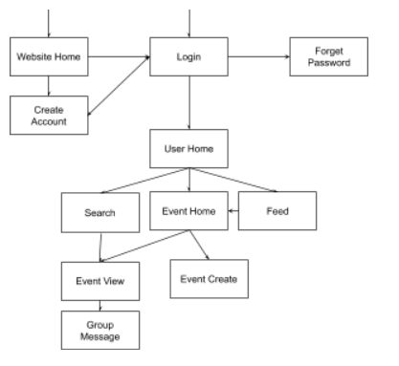
Server site map

Slide 10
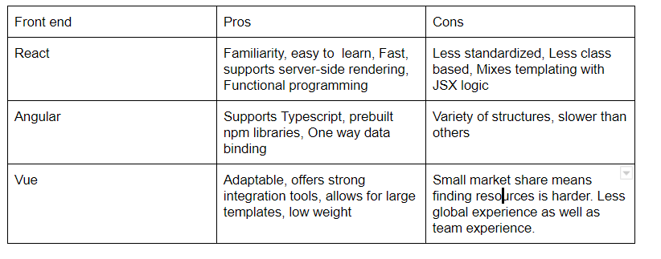
Trade off Analysis: Front end

Slide 11
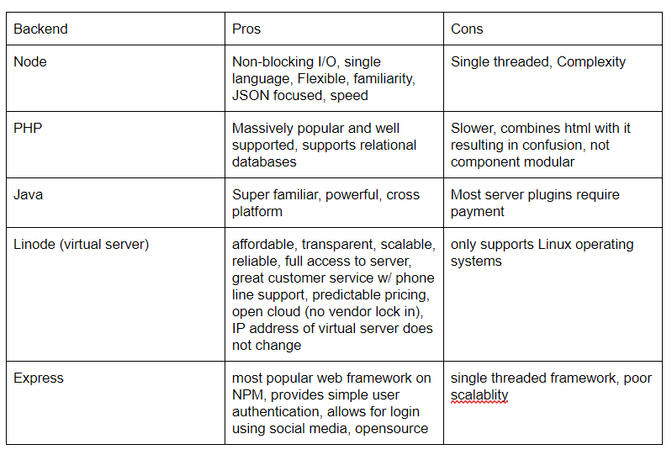
Trade off Analysis: Back end

Slide 12
MongoDB vs SQL
MongoDB is more like languages we are used to as opposed to SQL’s query structure.
MongoDB is more flexible, allowing for unique fields whereas in SQL the schema must be strictly followed
Less risk of attack due to object querying
More growth potential

Slide 13
User Stories
As a user, I want to be able to register an account easily from the home page so that I can have a unique login for myself to use the site.
As a user, I want to be able to log into my account quickly from the home page so that I can access all of the features of the site.

Slide 14
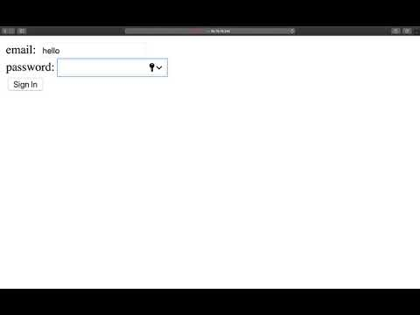
Code Demo

Slide 15
Sprint #2 Goal
Achievements:
Started code implementation, with login page
Worked on UI designs for Home Page, Login Screen, and Registration
Completed multiple machine learning assignments (Credit Card, Music Recommendation, Gradient Descent)
Our goal this sprint was to begin software and code development, stay up to date with all our product requirements, and complete all the necessary class assignments.

Slide 16
Story Points Planned: 60
Story Points Achieved: 52

Slide 17
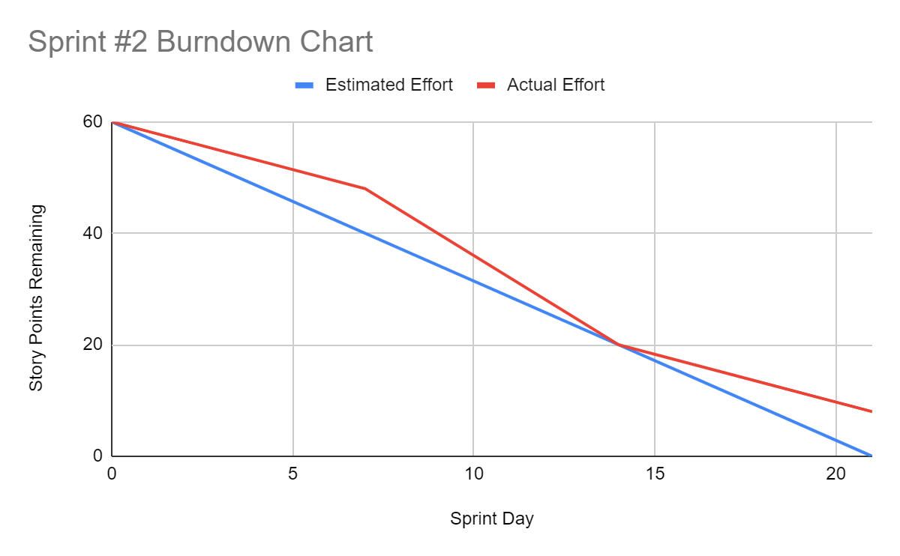
Burndown Chart

Slide 18
Sprint Retrospective
What needs improvement?
Time management Proactivity
Overall, what have we learned?
Machine learning introduction Power rule
What worked well?
Team chemistry and morale
Inter-team relations, communication, and collaboration
What are we committing to in the next sprint?
Continuing code development Maintaining productivity

